Slide 1

Incrementality Measurement: Creators
April , 2026

Slide 2
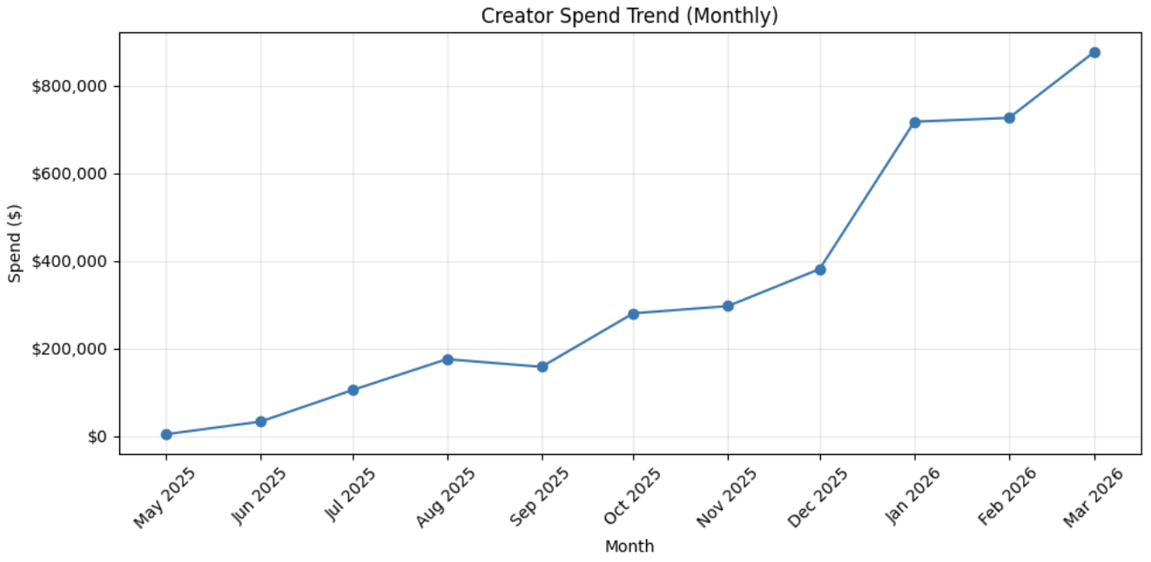
Evaluating the Impact of Increased Creator Spend
Creator Spend Increased Significantly in Early 2026
Context:
Baseline Creator Spend (Oct - Dec 25) : ~$300k/month
Ramp up Creator Spend (Jan - Mar 26) : ~$700k/month
Total paid marketing spend: ~$30M/month
Creators scaled from ~1% → ~2–3% of total spend
At this scale, creators are unlikely to drive detectable changes in aggregate metrics

Slide 3
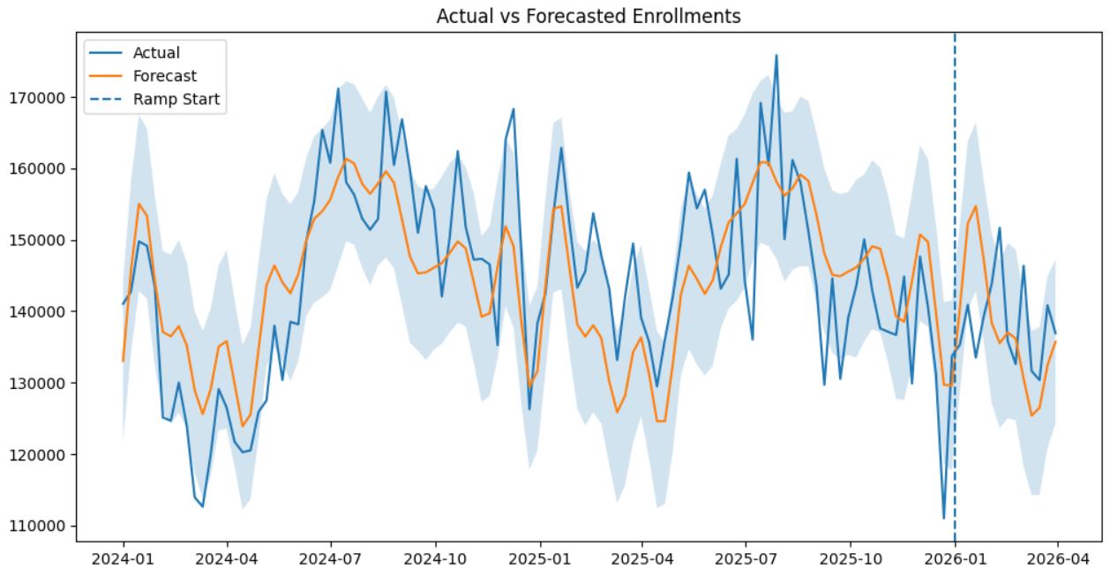
No Detectable Change in Total Enrollments After Creator Spend Increase
Approach:
Built baseline using pre ramp data (2024 – 2025)
Forecasted expected enrollments without creator ramp
Compared actual vs expected after Jan 2026
Observation:
Enrollments remained within expected range after Jan 2026
No sustained deviation above baseline
Increasing creator spend from ~$300K to ~$700–800K/month did not produce a measurable lift in overall enrollments.
At current scale (~2–3% of spend), creators are not producing a detectable impact on overall conversion metrics.

Slide 4
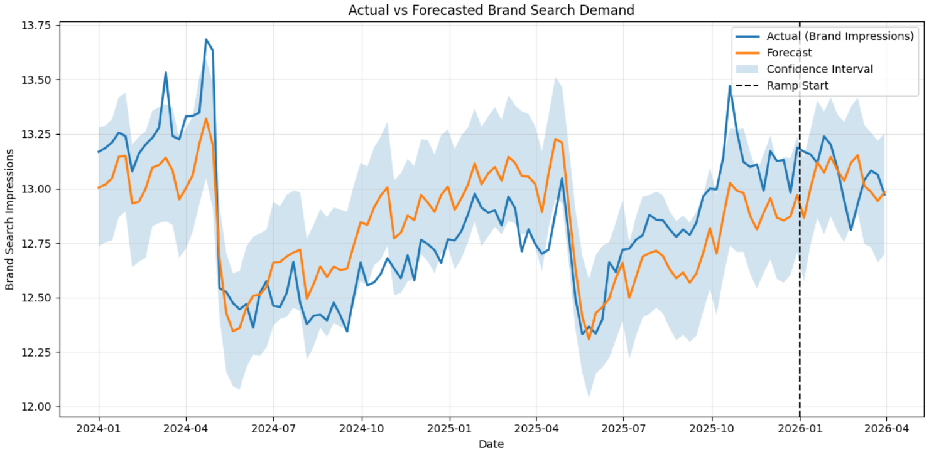
No Detectable Change in Brand Search Demand After Creator Spend Increase
Why Brand Search?
Proxy for top of funnel demand
Should increase if creators are driving awareness
Approach:
Built baseline using pre ramp data (2024 – 2025)
Forecasted expected enrollments without creator ramp
Compared actual vs expected post Jan 2026≈
Observation:
Brand Search Demand remained within expected range after Jan 2026
No sustained deviation above baseline
Increasing creator spend did not produce a measurable lift in brand search demand

Slide 5
Evaluating the Impact of Increased Creator Spend
Creator Spend Increased Significantly in Early 2026
Context:
Baseline Creator Spend (Oct - Dec 25) : ~$300k/month
Ramp up Creator Spend (Jan - Mar 26) : ~$700k/month
Total paid marketing spend: ~$30M/month
Creators scaled from ~1% → ~2–3% of total spend
At this scale, creators are unlikely to drive detectable changes in aggregate metrics

Slide 6
Takeaways and Next Steps
Key Takeaways
Increasing creator spend from ~$300K → ~$700–800K/month did not produce a measurable lift in overall enrollments or brand search demand
Creator impact is likely too small relative to overall system noise to be detected in aggregate metrics
Next Steps
1. Incorporate creators into MMM
Evaluate alongside full marketing mix to isolate contribution
2. Create larger, structured spend variation
Introduce clear step changes in spend (e.g., near $0 → ~$1M)
Run for defined time windows (4 - 6 weeks) to generate measurable signal
At current scale, creator impact is not detectable in aggregate metrics and requires either larger controlled variation or MMM to measure reliably

Slide 7
Thank You!

Slide 8
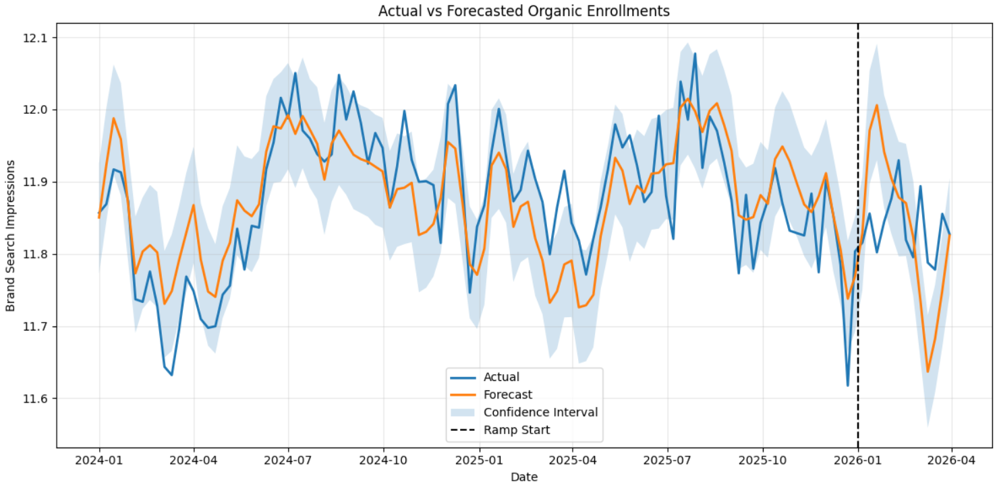
No Detectable Change in Organic Enrollments After Creator Spend Increase
Why Organic Enrollments?
Proxy for top of funnel demand
Should increase if creators are driving awareness
Approach:
Built baseline using pre ramp data (2024 – 2025)
Forecasted expected enrollments without creator ramp
Compared actual vs expected post Jan 2026≈
Observation:
Brand Search Demand remained within expected range after Jan 2026
No sustained deviation above baseline
Increasing creator spend did not produce a measurable lift in brand search demand

